Slide 1
Family
Proportion
Sample
family day 1 bar plot total.pdf

Slide 2
Family
Proportion
Sample
family shed non shed subset total.pdf
Notes:
"10A", "18E", "1D", "38A", "45D", "48B", "50E", "57B", "58C", "63E", "67A",
"6D", "74C", "8C",

Slide 3
Phylum
Proportion
All Samples, Day 1
phylum by total all day 1 samples

Slide 4
OTU level bray curtis nmds
Presence of O157
Absent
Present
NMDS 2
NMDS 1

Slide 5
Unweighted unifrac at OTU level
Axis 2 (3.6%)
Presence of O157
Absent
Present
Axis 1 (6.2%)
2 3.6
1 6.2

Slide 6
Family
Proportion
O157 (+)
O157 (-)
Notes:
"10A", "18E", "1D", "38A", "45D", "48B", "50E", "57B", "58C", "63E", "67A",
"6D", "74C", "8C",
"14E", "15A", "20B", "24C", "29D", "34E", "35A", "39B", "42C", "44D",
"52E", "53A", "55B", "60C")

Slide 7
Family
Proportion
Sample
Family
Proportion
O157 (+)
O157 (-)

Slide 8
A
C
Presence of O157
Absent
Present
Phylum
NMDS 2
Proportion
All Samples, Day 1
NMDS 1
B
D
Family
Axis 2 (3.6%)
Proportion
Presence of O157
Absent
Present
O157 (+) Samples
O157 (-) Samples
Axis 1 (6.2%)

Slide 9
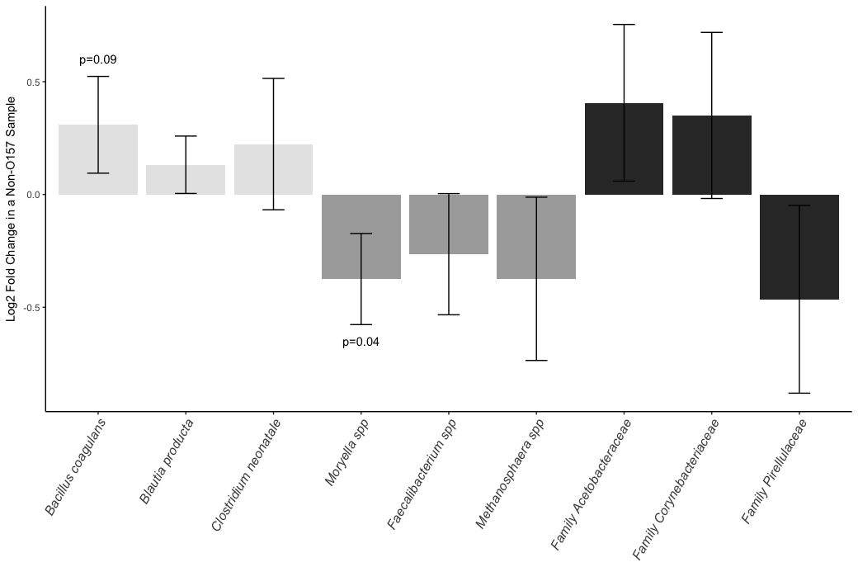
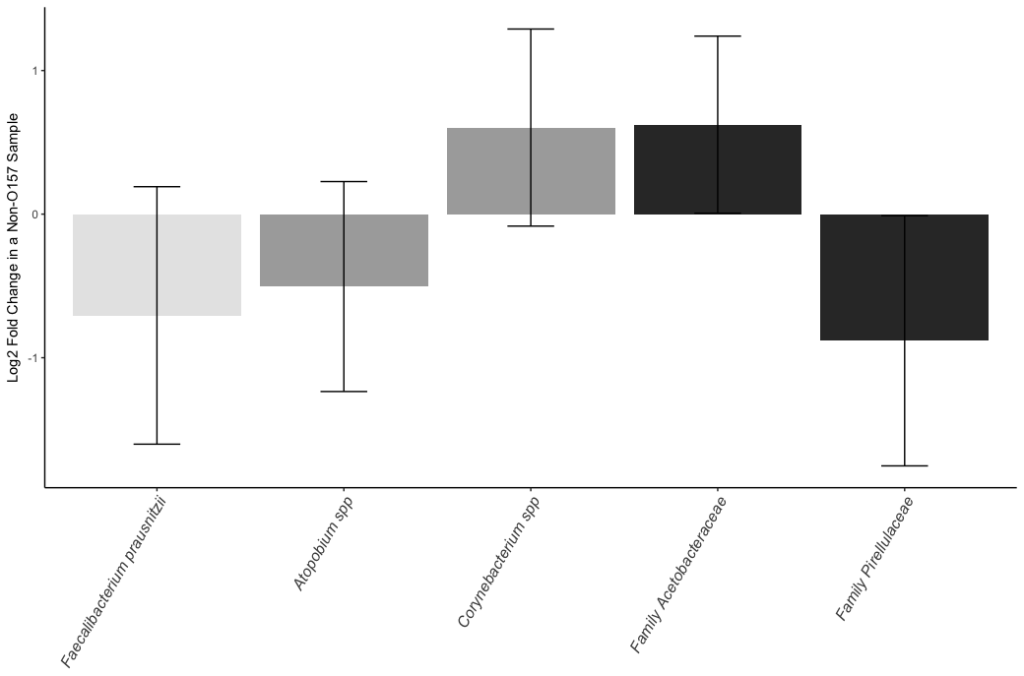
A
B

Slide 10
Parity
Farm
(TMR, environment, etc)
Fecal Alpha (α) Diversity
Richness/Shannons/Evenness (Exposure)
E.coli O157 Outcome
Pathotype/Pattern/Ever,Never (Disease)
Days in Milk
Disease

Slide 11
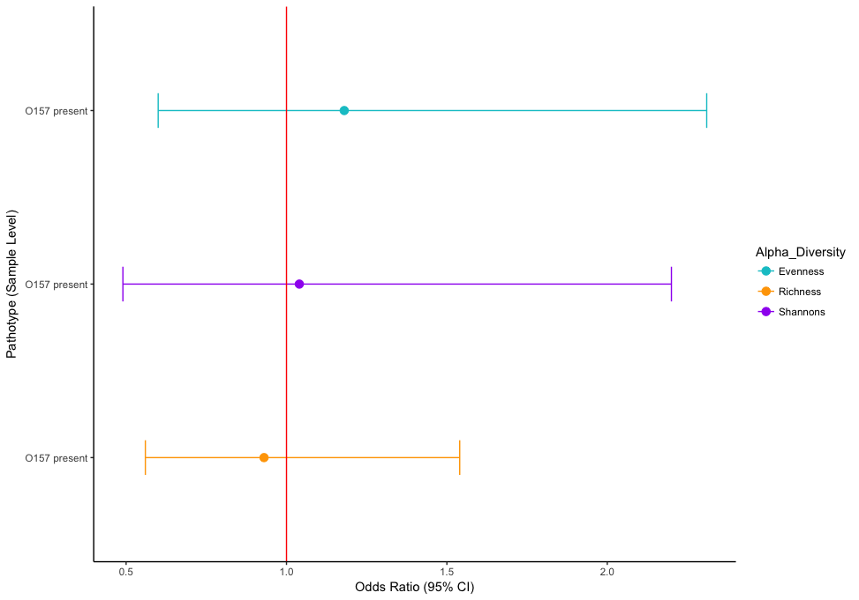
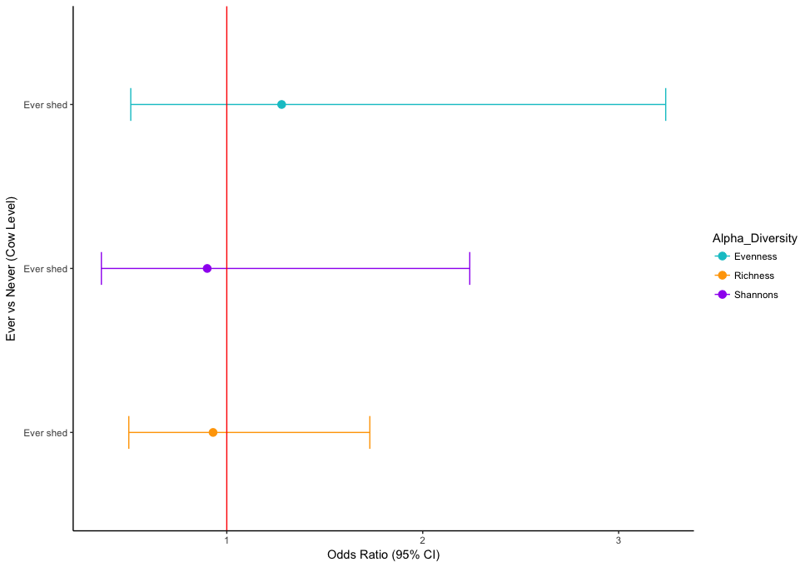
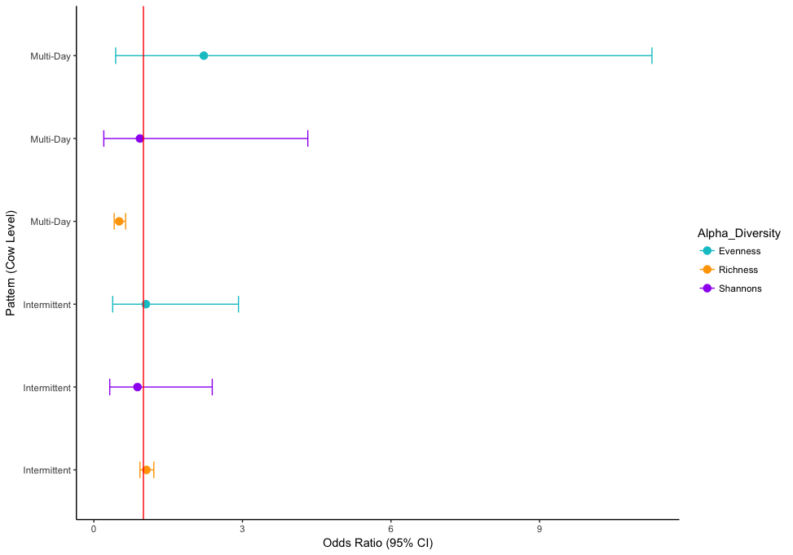

Slide 12
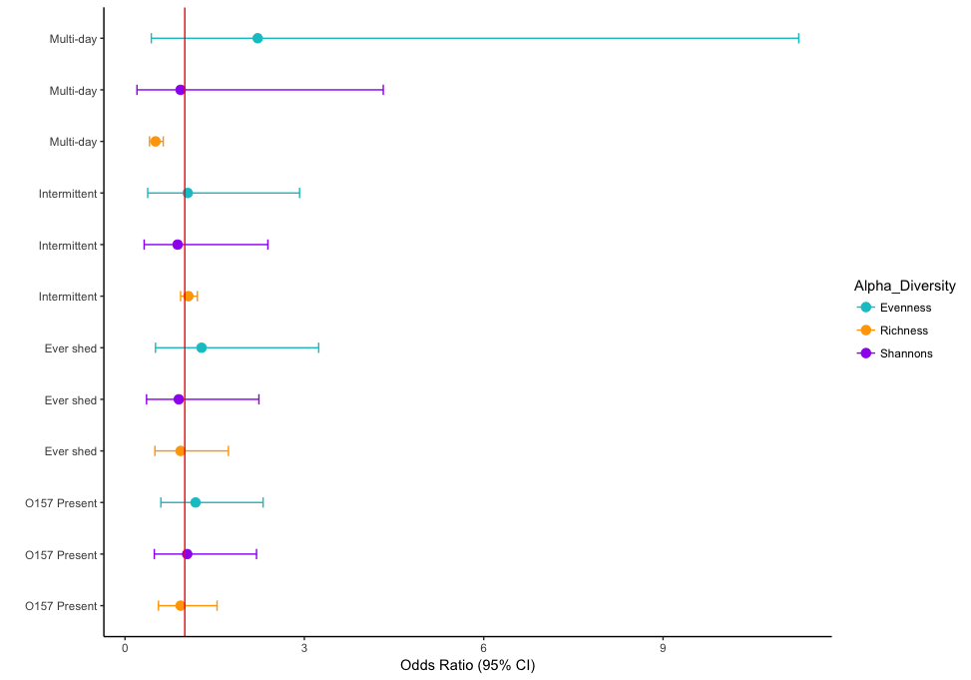
Pattern (Cow level)
Ever vs Never (Cow level)
Pathotype (Sample level)

Slide 13
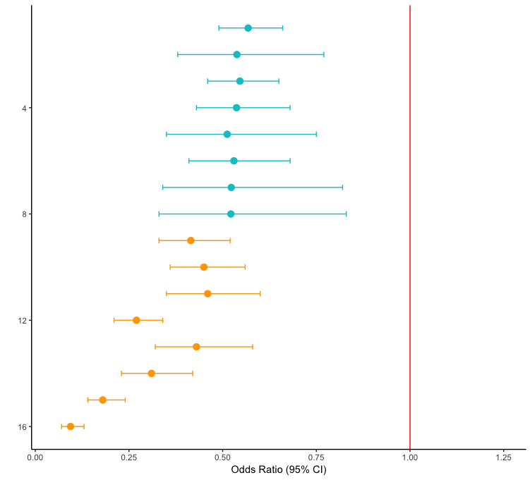
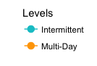
Crude
Parity
Treatment
Farm
Treatment + Parity
Treatment + Farm
Parity + Farm
Parity + Farm + Treatment
Adjustment Variables in Richness Models
Crude
Parity
Treatment
Farm
Treatment + Parity
Treatment + Farm
Parity + Farm
Pattern
Parity + Farm + Treatment

